Slide 1
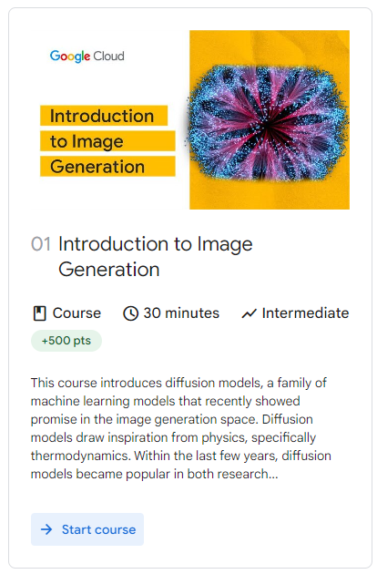

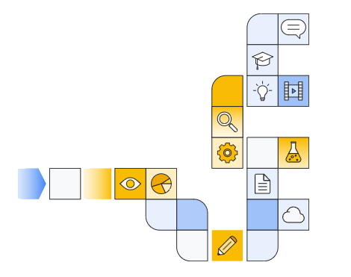

Notes:
https://www.cloudskillsboost.google/paths/118/course_templates/539

Slide 2
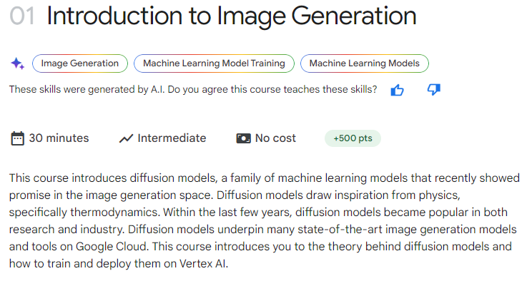
Notes:
https://www.cloudskillsboost.google/paths/183/course_templates/541

Slide 3
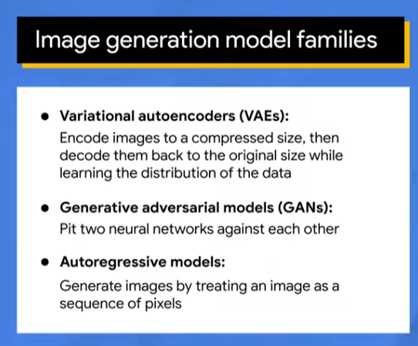

Slide 4
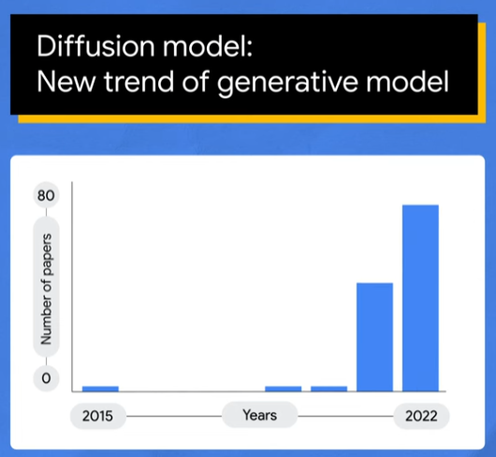

Slide 5
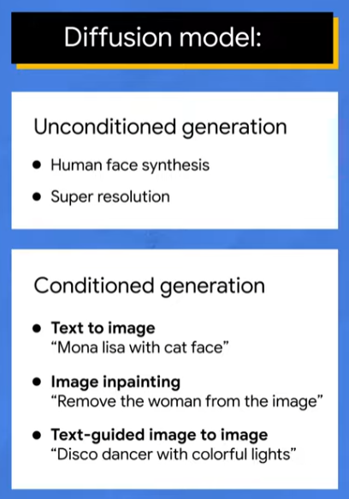

Slide 6
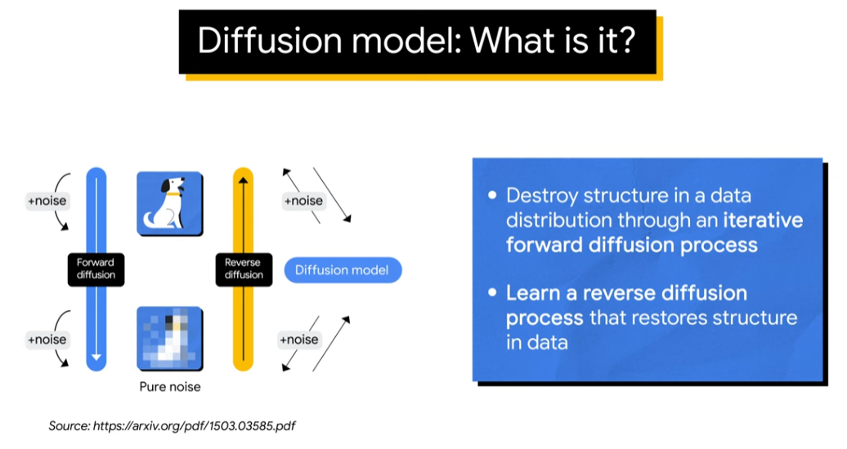

Slide 7
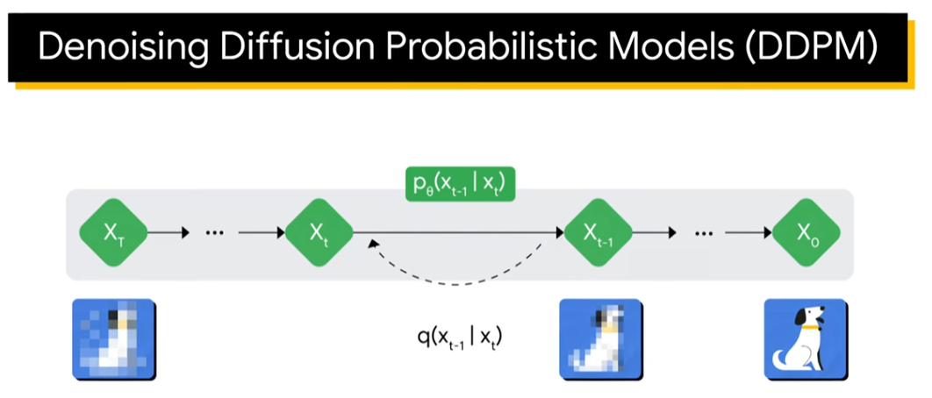

Slide 8
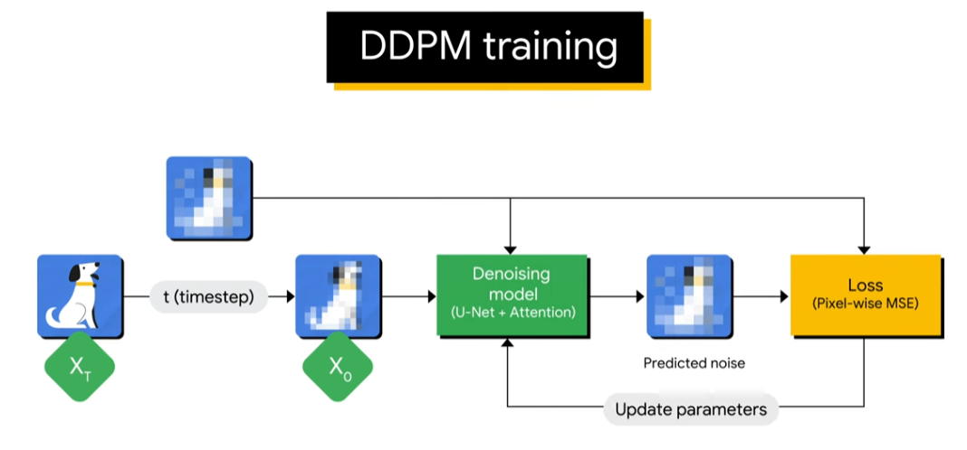

Slide 9
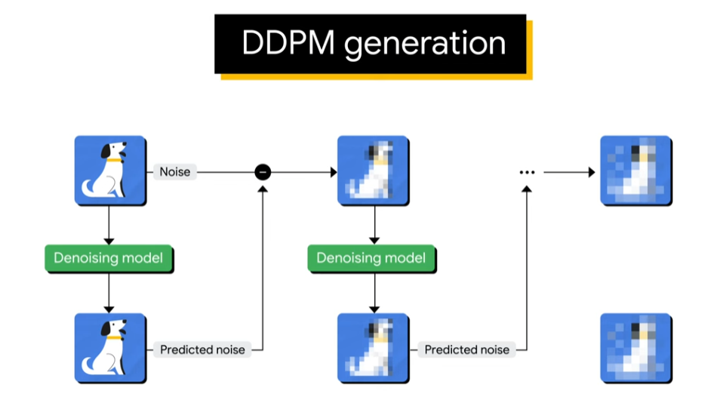

Slide 10
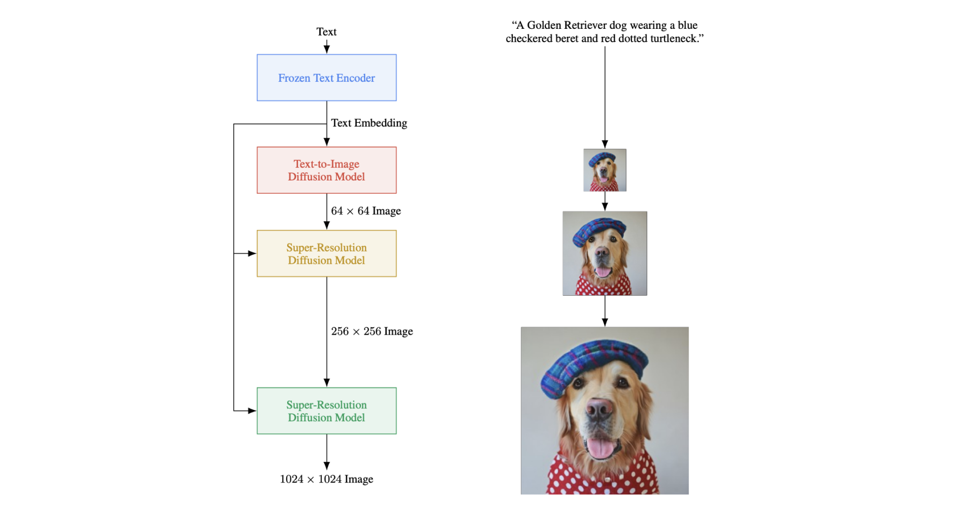
Notes:
https://www.edge-ai-vision.com/2023/01/from-dall%C2%B7e-to-stable-diffusion-how-do-text-to-image-generation-models-work/

Slide 11
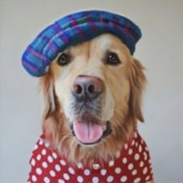
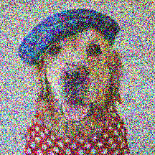
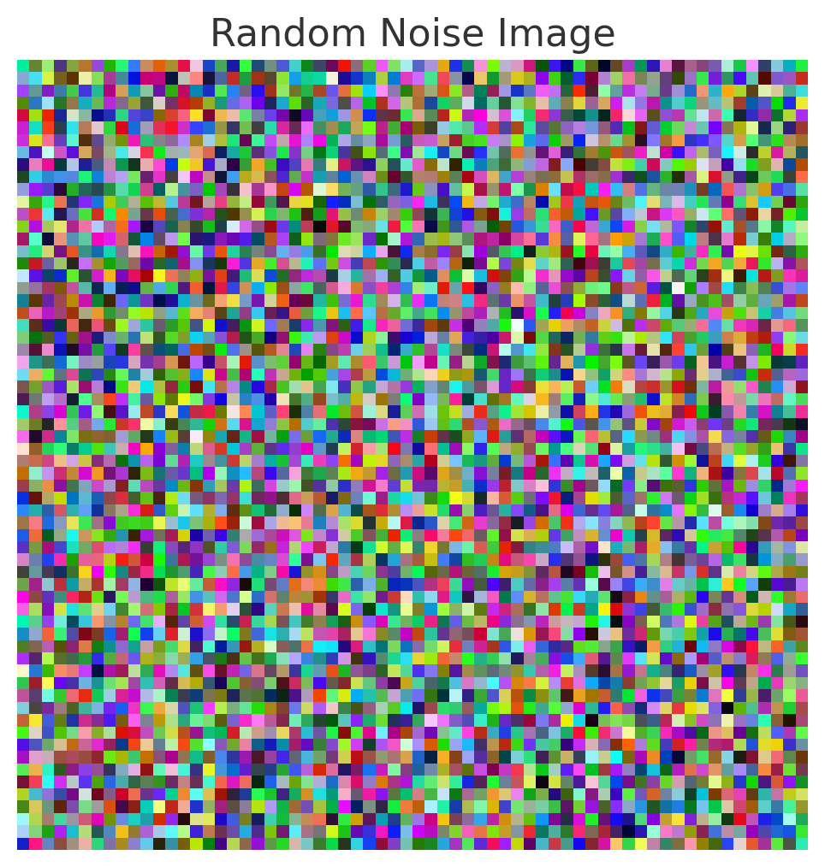
Getting from Text to image
Original Text
Embedding
“A Golden Retriever dog wearing a blue checkered beret and red dotted turtleneck.”
0.1245, -0.9354, 0.4578, -0.2674, 0.1289, 0.6543, -0.7821, 0.3487, -0.1245, 0.8572, 0.4721, -0.6875, 0.2314, -0.9756, 0.5621, 0.6894, -0.8743, 0.4587, -0.2365, 0.6957,
Imagen

Slide 12
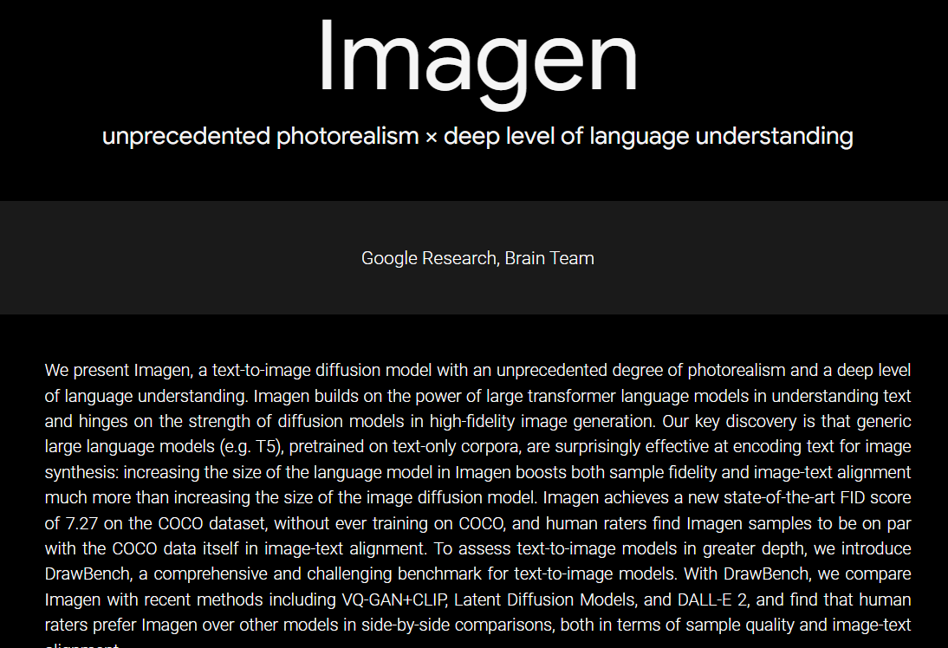
Notes:
https://imagen.research.google/

Slide 13
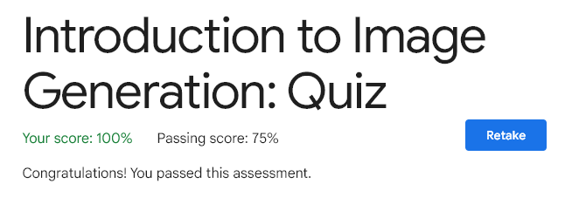

Slide 14


